Slide 1

C Programming
Dr. D. Y. Patil Pratishthan’s Institute for Advanced Computing and Software Development

Slide 2
Classification of generations of computers
The evolution of computer technology is often divided into five generations.
Generations of computers | Generations timeline | Evolving hardware
First generation | 1940s-1950s | Vacuum tube based
Second generation | 1950s-1960s | Transistor based
Third generation | 1960s-1970s | Integrated circuit based
Fourth generation | 1970s-present | Microprocessor based
Fifth generation | The present and the future | Artificial intelligence based

Slide 3
Classification of Computers by Size
Supercomputers
Mainframe computers
Minicomputers
Personal computers (PCs) or microcomputers

Slide 4
Define Computer Program
Program is a set of instructions
Given in a particular sequence
Having a predefined meaning
E.g:-
An instruction is a combination of some words. Which have a predefined meaning.
Instructions are given in a particular sequence.
C=a+b
Display c
instruction

Slide 5
What is Programming Language
Are Classified into two type:
1)Low Level Language:-
a)Machine Level Language:-combination of 0 zeros and 1
b)Assembly Language:-some symbols called mnemonic
-----------------------------------------------------------------
2)High Level Language:-English(Human readable language)

Slide 6
Translator:-
Assembler:-Used by assembly language.
Compiler:-used by C ,C++(translation, linking ,loading),Covert complete program & run (object code is created)
Interpreter:-line by line conversion only translation(not object code )

Slide 7
What is Programming Language
Are Classified into two type:
1)Low Level Language:-
a)Machine Level Language:-combination of 0 zeros and 1
b)Assembly Language:-some symbols called mnemonic
-----------------------------------------------------------------
2)High Level Language:-human readable language i.e.English
3)Middle Level Language:-C Language

Slide 8
Translators
Any program written in a high level language is known as source code. However, computers cannot understand source code. Before it can be run, source code must first be translated into a form which a computer understands - this form is called object code.
A translator is a program that converts source code into object code. Generally, there are three types of translator:
compilers
interpreters
assemblers

Slide 9
Compilers
A compiler takes the source code as a whole and translates it into object code all in one go. Once converted, the object code can be run unassisted at any time. This process is called compilation.
Compilers have several advantages:
Compiled programs run quickly, since they have already been translated.
A compiled program can be supplied as an executable file. An executable file is a file that is ready to run. Since an executable file cannot be easily modified, programmers prefer to supply executables rather than source code.
Compilers optimize code. Optimized code can run quicker and take up less memory space

Slide 10
Compilers
Compilers have several disadvantages:
Because the source code is translated as a whole, there must be enough memory space to hold the source code, the compiler and the generated object code. There also needs to be temporary working space for the compiler to perform the translation. Modern systems either have enough memory or use virtual memory to hold all the data.
Compilers do not usually spot errors - the program has to be compiled and run before errors are encountered. This makes it harder to see where the errors lie.
The source code must be re-compiled every time the programmer changes the program.
Source code compiled on one platform will not run on another - the object code is specific to the processor's architecture.

Slide 11
Interpreters
An interpreter translates source code into object code one instruction at a time. It is similar to a human translator translating what a person says into another language, sentence by sentence, as they speak. The resulting object code is then executed immediately. The process is called interpretation.
Interpreters have several advantages:
Instructions are executed as soon as they are translated.
Since instructions are executed once translated, they are not stored for later use. As a result, interpreters require less available memory.
Errors can be quickly spotted - once an error is found, the program stops running and the user is notified at which part of the program the interpretation has failed. This makes interpreters extremely useful when developing programs.

Slide 12
Interpreters
Interpreters also have several disadvantages:
Interpreted programs run more slowly as the processor has to wait for each instruction to be translated before it can be executed.
Additionally, the program has to be translated every time it is run.
Interpreters do not produce an executable file that can be distributed. As a result, the source code program has to be supplied, and this could be modified without permission.
Interpreters do not optimize code - the translated code is executed as it is.

Slide 13
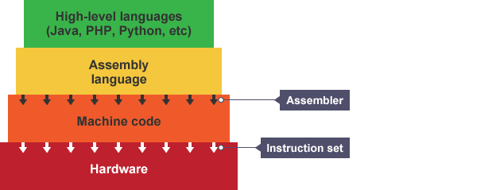
Assemblers
Assemblers are a third type of translator. The purpose of an assembler is to translate assembly language into object code. Whereas compilers and interpreters generate many machine code instructions for each high level instruction, assemblers create one machine code instruction for each assembly instruction.

Slide 14
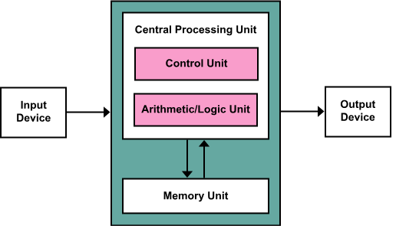
Programming Instructions
A Computer has two inseparable parts:-
Hardware and Software

Slide 15
What is Software & Hardware?
The instructions are the software
The physical component of a computer that are used in the process are hardware.
Application S/W:- software that fulfills a specific need or performs tasks
System S/W:- is designed to run a computer's hardware and provides a platform for applications to run on top of.

Slide 16
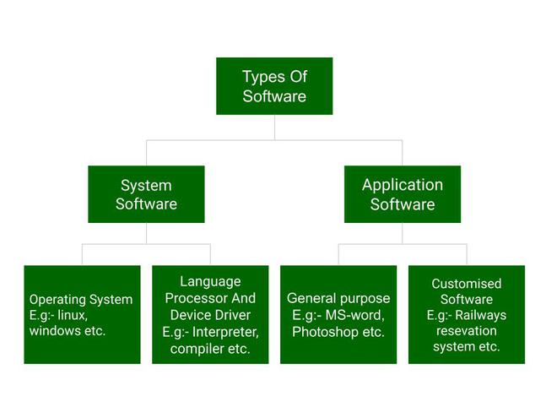
Types of Software

Slide 17
Why Number System:-
a,b and c are numbers
C=a+b
Display c
Input as well as output have to be understood by the computer and the user respectively
A number system plays an important role so that the same instructions can be manipulated by giving different numbers as input.

Slide 18
Number System:-
Way of counting things
Computer use different types of number systems.
1.Decimal(base 10)
2.Binary(base 2) 0 1
3.Octal(base 8)
4.Hexadecimal(base 16)

Slide 19
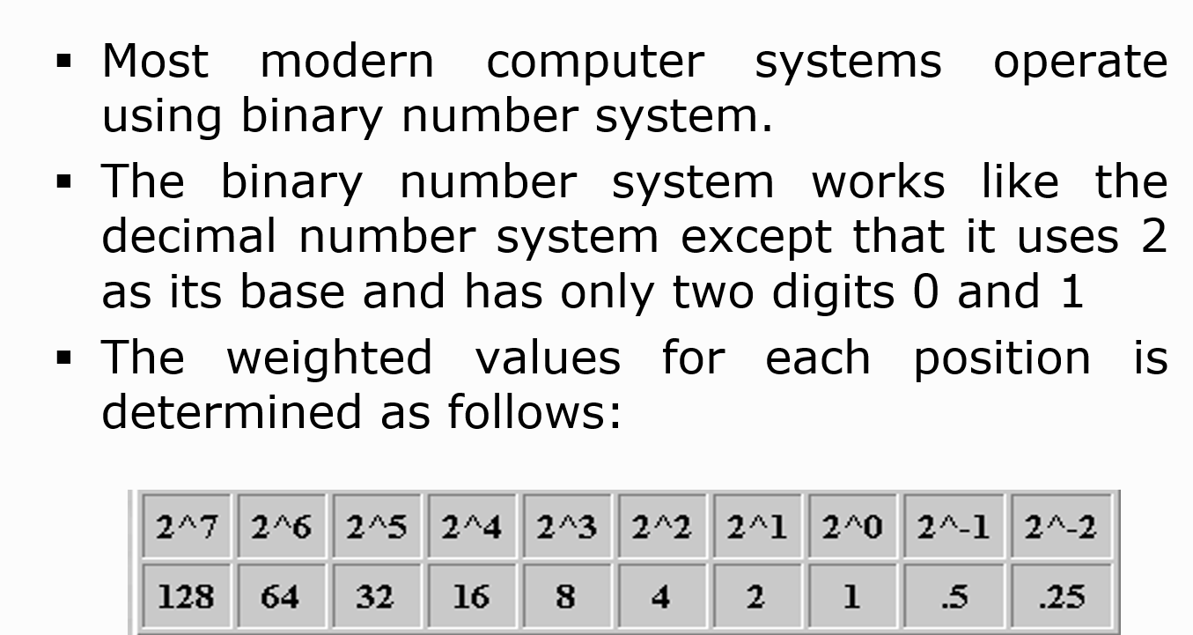
Binary Number System:-

Slide 20
Algorithm:
----The word Algorithm means “a process or set of rules to be
followed in calculations or other problem-solving operations”.
-----Therefore Algorithm refers to a set of rules/instructions
that step-by-step define how a work is to be executed upon
In order to get the expected results.

Slide 21
Flowchart:-
A flowchart is the graphical or pictorial representation of an algorithm with the help of different symbols, shapes, and arrows to demonstrate a process or a program. With algorithms, we can easily understand a program. The main purpose of using a flowchart is to analyze different methods. Several standard symbols are applied in a flowchart:
The symbols above represent different parts of a flowchart. The process in a flowchart can be expressed through boxes and arrows with different sizes and colors. In a flowchart, we can easily highlight certain elements and the relationships between each part.

Slide 22
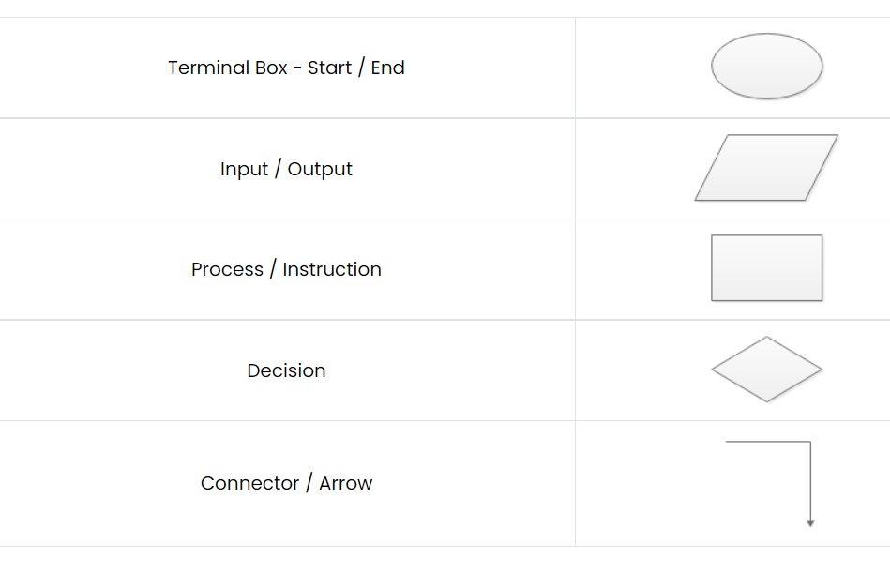
Flowchart & Symbols:-

Slide 23
Difference between Algorithm and Flowchart
Algorithm | Flowchart
Algorithm is the step-by-step instruction to solve a specific problem. | Flowchart is a pictorial representation to show the algorithm using geometrical diagrams and symbols.
Difficult to understand compared to flowcharts | Easier to understand
Complex representation of branching and looping | Easy representation of branching and looping
Easy debugging of errors | Difficult debugging of errors
Does not follow any rules to write | Has certain predefined rules of construction

Slide 24
Why not English why C?
Natural Language are ambiguous by nature.
--Bank-a financial institution or an edge of a river.
--Good-can mean useful or pleasing
Programming language are distinct and clear
Each word in a programming language has one & only one meaning. No two words mean the same.

Slide 25

History Of C
C programming language was developed in 1972 by Dennis Ritchie at bell laboratories of AT&T (American Telephone & Telegraph), located in the U.S.A.
Dennis Ritchie is known as the founder of the c language.
It was developed to overcome the problems of previous languages such as B, BCPL, etc.
Initially, C language was developed to be used in UNIX operating system. It inherits many features of previous languages such as B and BCPL

Slide 26
Before C Language:-
Language | Year | Developed By
Algol | 1960 | International Group
BCPL | 1967 | Martin Richard
B | 1970 | Ken Thompson
Traditional C | 1972 | Dennis Ritchie
K & R C | 1978 | Kernighan & Dennis Ritchie
ANSI C | 1989 | ANSI Committee
ANSI/ISO C | 1990 | ISO Committee
C99 | 1999 | Standardization Committee

Slide 27
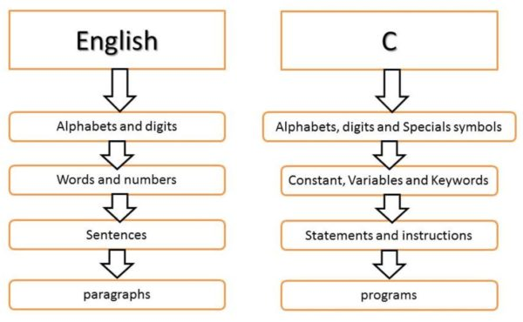
English Vs C

Slide 28
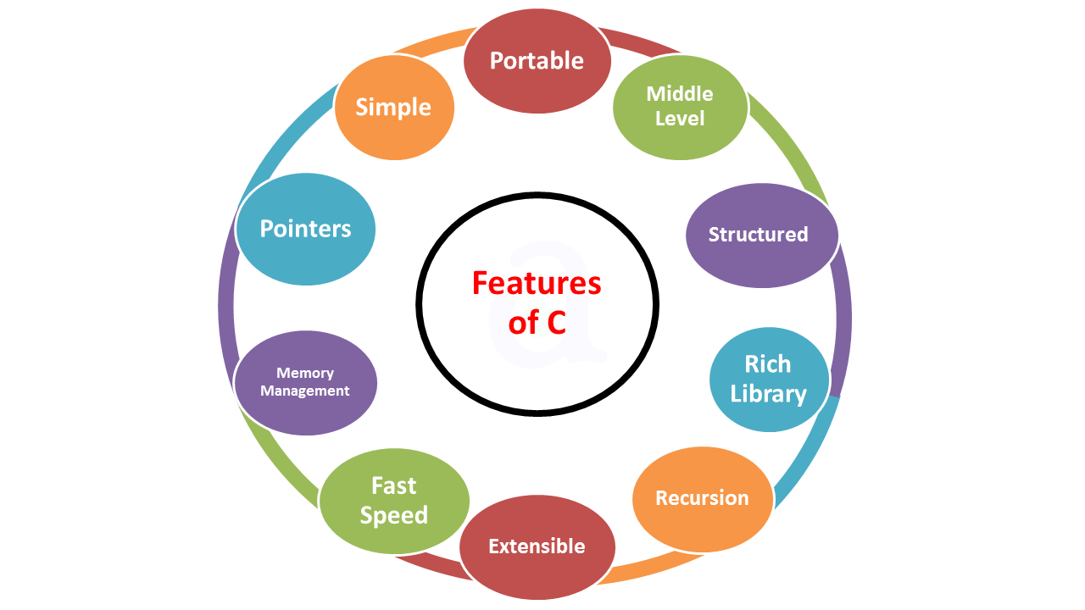
Features Of C:-

Slide 29
Simple C Program:-
#include<stdio.h>
int main()
{
printf(“Hello World”);
return 0;
}

Slide 30
Simple C Program:-
Line 1: [ #include <stdio.h> ] In a C program, all lines that start with # are processed by a preprocessor which is a program invoked by the compiler. In a very basic term, the preprocessor takes a C program and produces another C program. The produced program has no lines starting with #, all such lines are processed by the preprocessor. In the above example, the preprocessor copies the preprocessed code of stdio.h to our file. The .h files are called header files in C. These header files generally contain declarations of functions. We need stdio.h for the function printf() used in the program.

Slide 31
Simple C Program:-
Line 2: [int main() ]
main() is called more or less at the beginning of the program's execution, and when main() ends, the runtime system shuts down the program. main() always returns an int, as shown below:
main() has a special feature: There's an implicit return 0; at the end.
Thus if the flow of control simply falls off the end of main(), the value 0 is implicitly returned to the operating system. Most operating systems interpret a return value of 0 to mean "program completed successfully."

Slide 32
Simple C Program:-
Line 3 and 6: [ { and } ] In C language, a pair of curly brackets define scope and are mainly used in functions and control statements like if, else, loops. All functions must start and end with curly brackets.
Line 4 :-printf() is a standard library function to print something on standard output. The semicolon at the end of printf indicates line termination. In C, a semicolon is always used to indicate end of a statement
Line 5 [ return 0; ] The return statement returns the value from main(). The returned value may be used by an operating system to know the termination status of your program. The value 0 typically means successful termination. .

Slide 33
C Tokens
Keyword
Identifiers
Variables
Data Types
Character set
Constant
Operators

Slide 34
Character Set In C:-

Slide 35
Keywords in C
A keyword is a reserved word. You cannot use it as a variable name, constant name, etc. There are only 32 reserved words (keywords) in the C language.
A list of 32 keywords in the c language is given below:
auto | break | case | char | const | continue | default | do
double | else | enum | extern | float | for | goto | if
int | long | register | return | short | signed | sizeof | static
struct | switch | typedef | union | unsigned | void | volatile | while

Slide 36
C Identifiers
C identifiers represent the name in the C program, for example, variables, functions, arrays, structures, unions, labels, etc. An identifier can be composed of letters such as uppercase, lowercase letters, underscore, digits, but the starting letter should be either an alphabet or an underscore

Slide 37
Rules for constructing C identifiers:-
The first character of an identifier should be either an alphabet or an underscore, and then it can be followed by any of the character, digit, or underscore. E.g.num1,_num1,NUM1,Num1
It should not begin with any numerical digit.
In identifiers, both uppercase and lowercase letters are distinct. Therefore, we can say that identifiers are case sensitive.
Commas or blank spaces cannot be specified within an identifier.
Keywords cannot be represented as an identifier.
The length of the identifiers should not be more than 31 characters.
Identifiers should be written in such a way that it is meaningful, short, and easy to read.

Slide 38
Variables in C
A variable is a name of the memory location. It is used to store data. Its value can be changed, and it can be reused many times.
It is a way to represent memory location through symbol so that it can be easily identified.
Let's see the syntax to declare a variable:
type variable_list;
10+20
Num1=10
Num2=20
int a=10,b=20;//declaring 2 variable of integer type
float f=20.8;
char c='A'

Slide 39
Rules for defining variables
Must be declared first use.
A variable can have alphabets, digits, and underscore.
A variable name can start with the alphabet, and underscore only. It can't start with a digit.
No whitespace is allowed within the variable name.
A variable name must not be any reserved word or keyword, e.g. int, float, etc.
For local variables ,declaration statements must be placed at the beginning of the block
For global variables, declaration statements must be placed before first function definition.

Slide 40
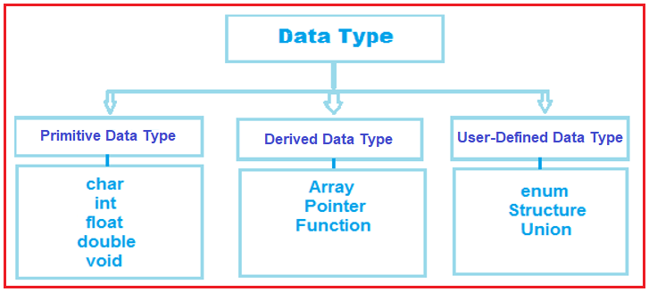
Data Types in C:-

Slide 41
Data Types in C
Each variable in C has an associated data type. Each data type requires different amounts of memory and has some specific operations which can be performed over it. Let us briefly describe them one by one: Following are the examples of some very common data types used in C:
Basic data types(Primitive )
char: The most basic data type in C. It stores a single character and requires a single byte of memory in almost all compilers.
char ch1=‘a’; %c
int: As the name suggests, an int variable is used to store an integer.
int num=10; %d
float: It is used to store decimal numbers (numbers with floating point value) with single precision.
float fnum=10.5; %f
double: It is used to store decimal numbers (numbers with floating point value) with double precision. Double dnum=10.657; %lf

Slide 42
Format Specifier
%c—Convert data into character
%d—Convert data into signed int.
%f—Convert data into float(6 precisions)
%lf:-convert data into long float(double)
%s—Converts data into string
%ld—Converts data into long int
%u—converts data into unsigned
%x—converts data into hexadecimal format
%o—Converts data into octal format
%e—Converts data into exponential format

Slide 43
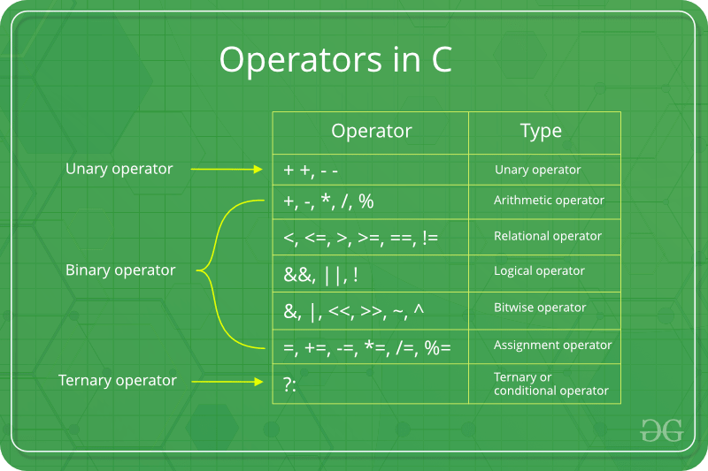
Operators in C

Slide 44
Header Files:-
Header File | What it does
stdio.h | Mainly used to perform input and output operations like print(), scanf().
string.h | Mainly used to perform string handling operations like strlen(), strcmp() etc.
conio.h | With this header file, you can execute console input and output operations.
stdlib.h | Mainly used to perform standard utility functions like malloc(), calloc() etc.
math.h | Mainly used to perform mathematical operations like sqrt(), pow() etc.
ctype.h | Used to perform character type functions like isdigit(), isalpha() etc.

Slide 45
Comments in C
Comments in C language are used to provide information about lines of code. It is widely used for documenting code. There are 2 types of comments in the C language.
Single Line Comments \\
Multi-Line Comments\*-----------*/
Single Line Comments
Single line comments are represented by double slash \\. Let's see an example of a single line comment in C.

Slide 46
C Identifiers
C identifiers represent the name in the C program, for example, variables, functions, arrays, structures, unions, labels, etc. An identifier can be composed of letters such as uppercase, lowercase letters, underscore, digits, but the starting letter should be either an alphabet or an underscore

Slide 47
Rules for constructing C identifiers:-
The first character of an identifier should be either an alphabet or an underscore, and then it can be followed by any of the character, digit, or underscore. E.g.num1,_num1,NUM1,Num1
It should not begin with any numerical digit.
In identifiers, both uppercase and lowercase letters are distinct. Therefore, we can say that identifiers are case sensitive.
Commas or blank spaces cannot be specified within an identifier.
Keywords cannot be represented as an identifier.
The length of the identifiers should not be more than 31 characters.
Identifiers should be written in such a way that it is meaningful, short, and easy to read.

Slide 48
Variables in C
A variable is a name of the memory location. It is used to store data. Its value can be changed, and it can be reused many times.
It is a way to represent memory location through symbol so that it can be easily identified.
Let's see the syntax to declare a variable:
type variable_list;
10+20
Num1=10
Num2=20
int a=10,b=20;//declaring 2 variable of integer type
float f=20.8;
char c='A'

Slide 49
Rules for defining variables
Must be declared first use.
A variable can have alphabets, digits, and underscore.
A variable name can start with the alphabet, and underscore only. It can't start with a digit.
No whitespace is allowed within the variable name.
A variable name must not be any reserved word or keyword, e.g. int, float, etc.
For local variables ,declaration statements must be placed at the beginning of the block
For global variables, declaration statements must be placed before first function definition.

Slide 50
Data Types in C:-

Slide 51
Data Types in C
Each variable in C has an associated data type. Each data type requires different amounts of memory and has some specific operations which can be performed over it. Let us briefly describe them one by one: Following are the examples of some very common data types used in C:
Basic data types(Primitive )
char: The most basic data type in C. It stores a single character and requires a single byte of memory in almost all compilers.
char ch1=‘a’; %c
int: As the name suggests, an int variable is used to store an integer.
int num=10; %d
float: It is used to store decimal numbers (numbers with floating point value) with single precision.
float fnum=10.5; %f
double: It is used to store decimal numbers (numbers with floating point value) with double precision. Double dnum=10.657; %lf

Slide 52
Try Outs 1

Slide 53
ASCII in C
ASCII stands for American Standard Code for Information Interchange.
ASCII code is a character encoding scheme used to define the value of basic character elements for exchanging information in computers and other electronic devices.
the ASCII code is a collection of 255 symbols in the character set, divided into two parts, the standard ASCII code, and the extended ASCII code. The standard ASCII code ranges from 0 to 127, 7 bits long, and the extended ASCII code from 128 to 255 is 8 bits long. These characters are a combination of symbol letters (uppercase and lowercase (a-z, AZ), digits (0-9), special characters (!, @, #, $, etc.), punctuation marks, and control characters. Hence, we can say, each character has its own ASCII value.

Slide 54
Example:-
For example, when we enter a string as "HELLO", the computer machine does not directly store the string we entered. Instead, the system stores the strings in their equivalent ASCII value, such as '7269767679'. The ASCII value of H is 72, E is 69, L is 76, and O is 79.

Slide 55
Format Specifier
%c—Convert data into character
%d—Convert data into signed int.
%f—Convert data into float(6 precisions)
%s—Converts data into string
%ld—Converts data into long int
%u—converts data into unsigned
%x—converts data into hexadecimal format
%o—Converts data into octal format
%e—Converts data into exponential format

Slide 56
Comments in C
Comments in C language are used to provide information about lines of code. It is widely used for documenting code. There are 2 types of comments in the C language.
Single Line Comments \\
Multi-Line Comments\*-----------
Single Line Comments
Single line comments are represented by double slash \\. Let's see an example of a single line comment in C.

Slide 57
Escape Sequence in C:-
An escape sequence in C language is a sequence of characters that doesn't represent itself when used inside string literal or character.
Character Combination consisting of a backslash(\) followed by a letter. Or combination of digits is called escape sequence.
The backward slash is called the escape character because it makes Character following it escape from its original meaning and gives special meaning to it.

Slide 58
List of Escape Sequences in C
Escape Sequence | Meaning
\a | Alarm or Beep
\b | Backspace
\f | Form Feed
\n | New Line
\r | Carriage Return
\t | Tab (Horizontal)
\v | Vertical Tab
\\ | Backslash
\' | Single Quote
\" | Double Quote
\? | Question Mark
\nnn | octal number
\xhh | hexadecimal number
\0 | Null

Slide 59
Console I/O Functions:-
Classification of console I/O functions
Formatted I/O
Unformatted I/O
getchar, getch, getche putchar, putch,
gets ,puts
Scanf()
Printf()

Slide 60
Input Data:-
The field specification for reading an input number is :-%wd
W:- [is optional] is an integer number which specifies the field width of the number to be read.

Slide 61
Operator Precedence and Associativity in C
Operator precedence determines which operator is performed first in an expression with more than one operators with different precedence.
Operators Associativity is used when two operators of same precedence appear in an expression. Associativity can be either Left to Right or Right to Left. For example: ‘*’ and ‘/’ have same precedence and their associativity is Left to Right, so the expression “100 / 10 * 10” is treated as “(100 / 10) * 10”.

Slide 62
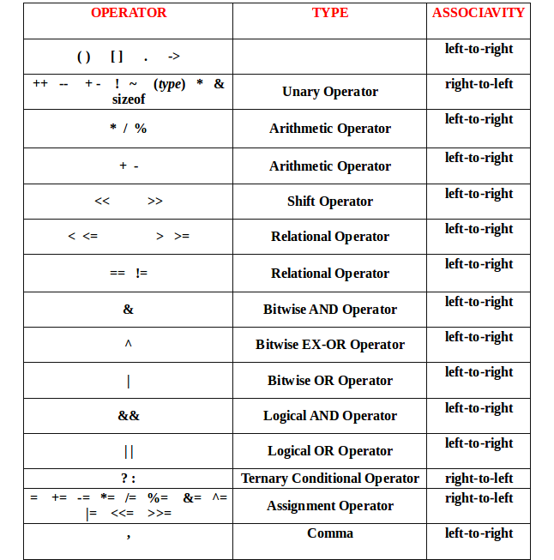
Operator Precedence and Associativity in C

Slide 63
Control Flow:-
A C program executes one command after another from top to bottom.
2) Is there any thing that altering the flow of the program.
Repeating commands according to the different statement.
3)I need control the flow of my program

Slide 64
C Control Statements:-
Decision & Selection Control Statements:-if –else , switch case, conditional operators
Looping :-While, do—while, for
Branching :-break, continue, return, goto

Slide 65
C if else Statement
The if-else statement in C is used to perform the operations based on some specific condition. The operations specified in if block are executed if and only if the given condition is true.
There are the following variants of if statement in C language.
If statement
If-else statement
If else-if ladder
Nested if

Slide 66
If Statement
The if statement is used to check some given condition and perform some operations depending upon the correctness of that condition. It is mostly used in the scenario where we need to perform the different operations for the different conditions. The syntax of the if statement is given below.
if(expression){
//code to be executed
}

Slide 67
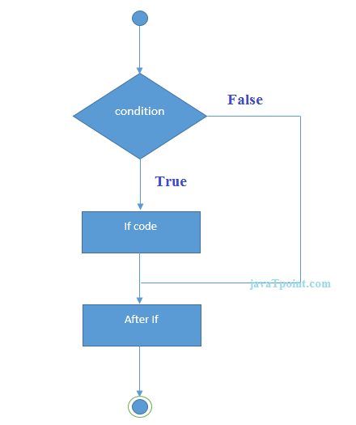
Flowchart of if statement in C

Slide 68
If-else Statement
The if-else statement is used to perform two operations for a single condition. The if-else statement is an extension to the if statement using which, we can perform two different operations, i.e., one is for the correctness of that condition(i.e true part), and the other is for the incorrectness of the condition(i.e false part). Here, we must notice that if and else block cannot be executed simultaneously Using if-else statement is always preferable since it always invokes an otherwise case with every if condition.

Slide 69
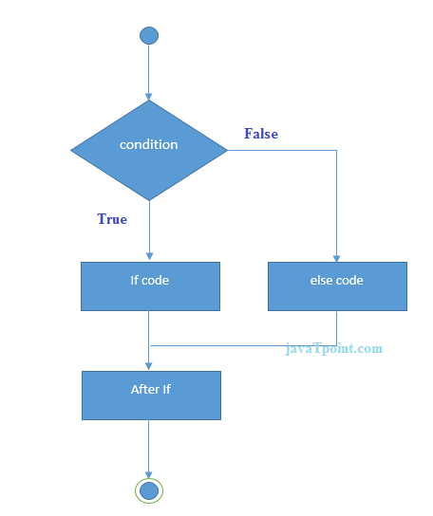
Syntax & Flowchart of if---else
if(expression)
{
//code to be executed if condiion is true
}
else{
//code to be executed if condition is false
}

Slide 70
If else-if ladder Statement
The if-else-if ladder statement is an extension to the if-else statement. It is used in the scenario where there are multiple cases to be performed for different conditions. In if-else-if ladder statement, if a condition is true then the statements defined in the if block will be executed, otherwise if some other condition is true then the statements defined in the else-if block will be executed, at the last if none of the condition is true then the statements defined in the else block will be executed.

Slide 71
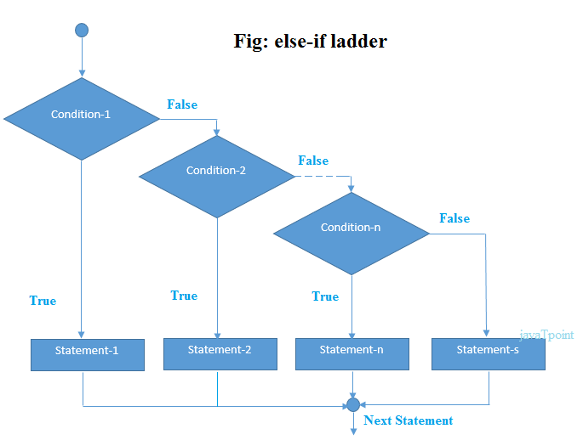
Syntax & Flowchart:-
if(condition1)
{
//code to be executed if condition1 is true
}else if(condition2){
//code to be executed if condition2 is true
}
else if(condition3){
//code to be executed if condition3 is true
}
...
else{
//code to be executed if all the conditions are false
}

Slide 72
Nested if—else
if(Condition1)//outer
{
if(Condition2)//inner
{
Statements;
else{
Statements;
}
if(condition3)
{-----}
else{
--------}
}

Slide 73
Conditional Operator(Ternary Operator)
Syntax:-
Expression1 ?Expression 2 :Expression3
Max=(num1>num2)? num1:num 2;

Slide 74
C Switch Statement
The switch statement in C is an alternate to if-else-if ladder statement which allows us to execute multiple operations for the different possibles values of a single variable called switch variable. Here, We can define various statements in the multiple cases for the different values of a single variable.
The Switch case statements is used for selective decision.
The keyword switch is followed by an expressions which must yield an integer or character value.

Slide 75
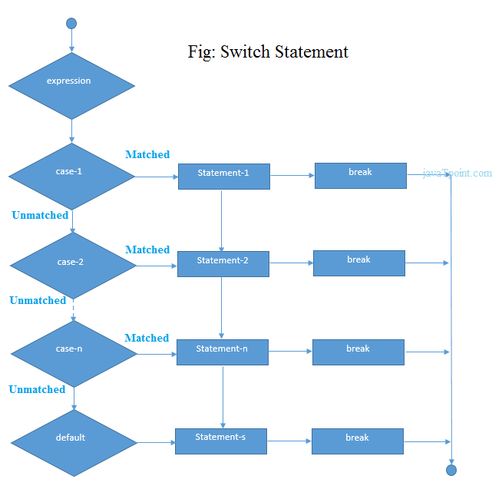
Syntax of Switch & Flowchart:-
switch(expression){
case value1:
//code to be executed;
break;
case value2:
//code to be executed;
break;
......
default:
code to be executed if all cases are not matched;
}

Slide 76
Rules for switch statement in C language
1) The switch expression must be of an integer or character type.
2) The case value must be an integer or character constant.
3) The case value can be used only inside the switch statement.
4) The break statement in switch case is not must. It is optional. If there is no break statement found in the case, all the cases will be executed present after the matched case. It is known as fall through the state of C switch statement.

Slide 77
Example:-
int x,y,z; case 1:2: 3 (invalid) case 1:
case 1:2:3(not allowed)
char a,b;
float f;
Valid Switch | Invalid Switch | Valid Case | Invalid Case
switch(x) | switch(f) | case 3; | case 2.5;
switch(x>y) | switch(x+2.5) | case 'a'; | case x;
switch(a+b-2) |  | case 1+2; | case x+2;
switch(func(x,y)) |  | case 'x'>'y'; | case 1,2,3;

Slide 78
Type Casting in C
Typecasting allows us to convert one data type into other. In C language, we use cast operator for typecasting which is denoted by (type).
Syntax:
(type)value;

Slide 79
C Loops
Loops are used when a task needs to be repeated a number of times
For example
Printing numbers from 1 to 100;
Printing even numbers from 1 to 50
Printing details of all bank customers
Sequentially searching a record in a file
Loops can be categorized as
1 Pre tested loop
2 Post tested loop

Slide 80
Point to Remember:-

